Slide 1

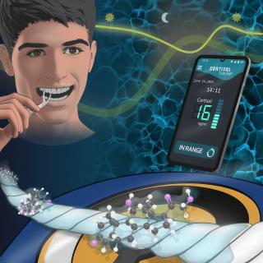
SalivaSens:
Rapid Saliva Diagnostics for Stress and Inflammation
Atul Sharma
Tufts University
School of Engineering

Slide 2

Market and Opportunity

Slide 3
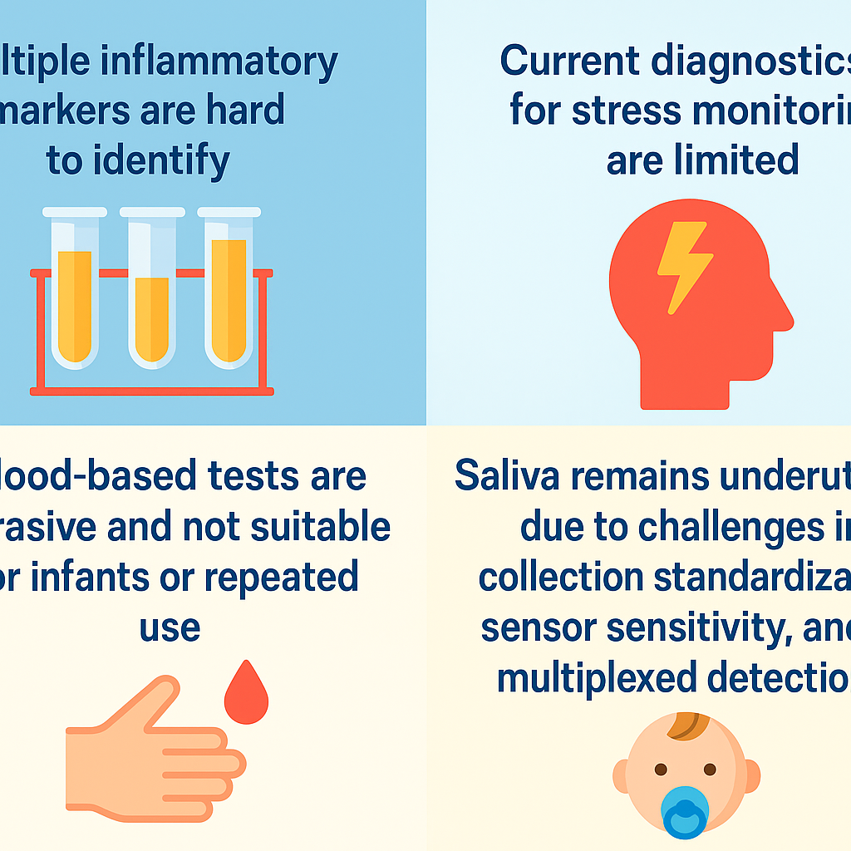

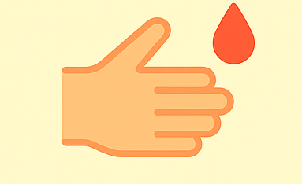
Challenges
Multiple inflammatory markers are hard to identify
Current diagnostics for stress monitoring are limited
Blood-based tests are invasive and not suitable for infants or repeated use
Mental health is commonly undiagnosed
Saliva remains underutilized due to challenges in collection standardization, sensor sensitivity, and multiplexed detection.

Slide 4
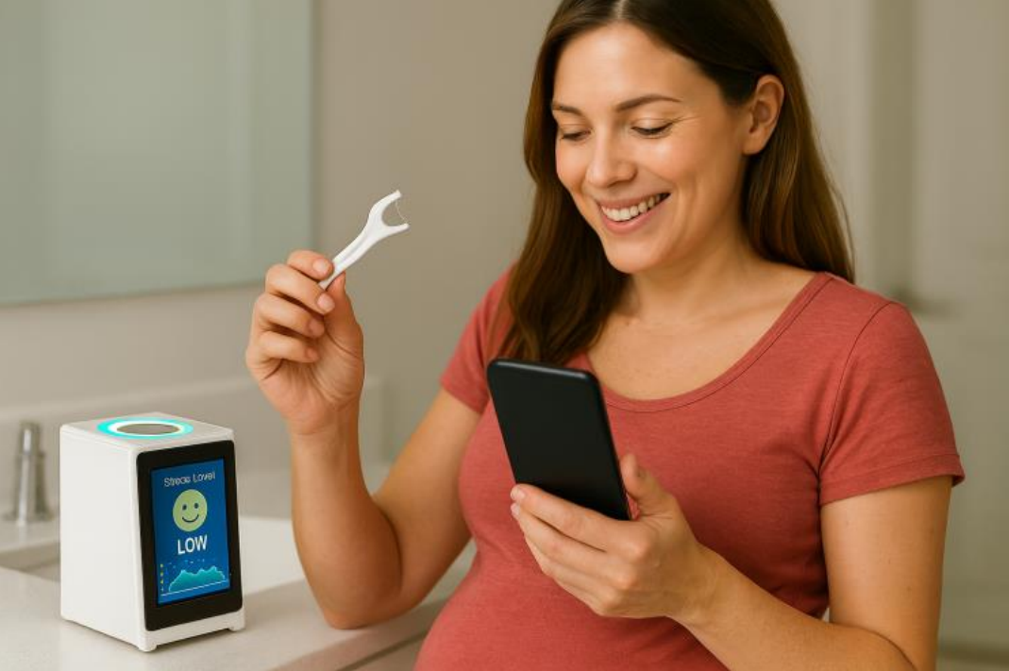
Innovations
SalivaSens: Rapid Non-Invasive Saliva-Based Screening Platforms
Rapid and Non-invasive saliva-based platform
User-friendly interface
FDA-approved and biocompatible materials
Integrating wellness tracking into a simple daily habit
Measures health biomarkers
Real-time AI-assisted readouts and feedback

Slide 5
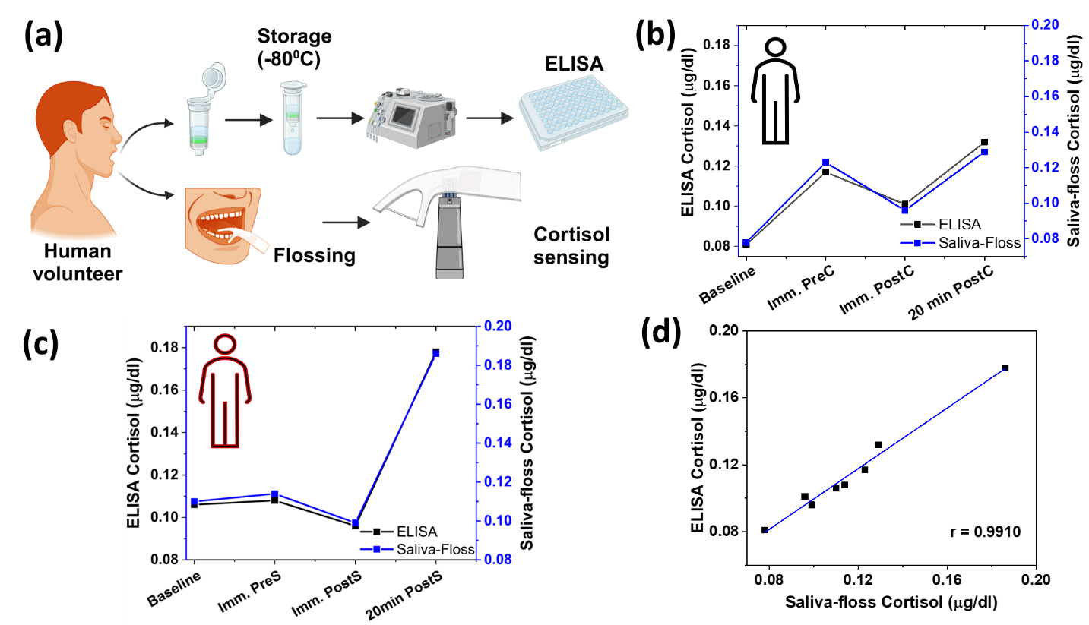
Proof-of-Concept and Validation
Stress Monitoring
Inflammation Monitoring
Validation with the standard ELISA (gold standard method) assay for accuracy and effectiveness
* Patents filed (Tufts Technology Transfer Office)

Slide 6




Impact
Women with poor maternal health
Individuals experiencing chronic health issues
Healthcare and Wellness providers

